Slide 1
Psychology 1200
Lecture 1

Slide 2

What Is Science?
A human activity, in fact, a very complex set of activities involving individuals, teams, corporations and publicly funded agencies.
The general purpose is to develop a better understanding of how the world works.
But related to this purpose there are all kinds of individual and organizational goals, motivations, etc.
For instance….
  1) Economic
  2) Social
  3) Political

Slide 3
What Is Science? Con’t
The principles of scientific activity…the ideals, the principles, the ideal orientation:
  Empirical/observational
  Oriented towards falsification not verification
  Based in a method… a way of doing things, not a feature of the result of doing things a certain way. So, not about truth or facts…about HOW TO LOOK.
  A sophisticated way of looking, not just looking. Important: We must be able to see what can not be ordinarily seen with ordinary observation.

Slide 4
What Is Science? Con’t
BUT…science is a HUMAN activity so all the weaknesses of any human activity can be found in science:
  Scientists have careers, mortgages, greed, egos, dreams of fame and success, just like all people do.
  Scientists have character and personality weaknesses, just like all people do.
The result is that science is often NOT:
  Rooted in the empirical…scientists are often motivated by ideology, values, belief systems, ego, etc.
  Oriented towards falsification.
  Acting in accordance with the rules to determine how things are but bending the rules to bias or influence the results and interpretations of their work.

Slide 5
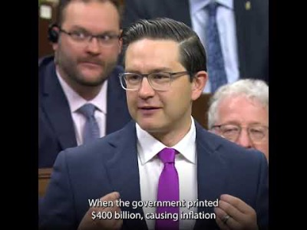
What Is Science? Con’t
The point is the same for ANY human activity. Since this is a course in psychology, we need to understand that human nature does not change depending upon the activity in which people are engaged.
Note: Of course, the same can be said of political affiliation. No one is purified of any of the weaknesses of human nature…irrespective of the political party with which they align.

Slide 6
The Scientific Method
Basic purpose:
  Description of how things are
  Prediction of how things will be
  Explanation of why things are the way they are
VERY IMPORTANT…Answer the following question…
How many reds does it take to make a long yellow?
NOW ANSWER THIS QUESTION….
Why is this page red?

Slide 7
NEVER FORGET!
MEANING FIRST
DESCRIPTION SECOND
EXPLANATION LAST

Slide 8
Why a Good Description Is Harder Than We Think.
It turns out the describing the way things are is extremely difficult.
Consider this question…At the present time is COVID-19 serious?
This is description question, what are the issues?

Slide 9
COVID: The Present State
  How do we define serious?
    What measure should we use? Deaths per million, total deaths, total cases, cases with symptoms, death rate, case transmission rate, deaths to local residents or global deaths, years lost or total deaths, deaths in relation to influenza in a normal year, deaths due to influenza last year, excess deaths in the population, deaths with Covid or deaths from Covid, total deaths now or in 2 years from now, in 10 years from now, etc.
    Who should define serious, should we all use the same definition of serious? Can we compare countries if different definitions are used by different countries, must the definition stay fixed over time, etc.

Slide 10
COVID: The Present State
  2) Does the seriousness depend upon third factors and if so, what are they?
    Which of the numerous ways of measuring seriousness are a function of age? Is age actually a risk factor or is it merely a mediator variable? Does ethnicity matter? What about pre-existing conditions, population density, immune system health, diet, geographic location, economic status of the population, economic status of the individual, etc.
  3) Does seriousness depend upon our ability to manage it?
    What about health care system capacity, sophistication of the health-care system, public or private health care system, social distancing measures used, mask wearing, therapeutics, vaccines, governmental orientation towards civil liberty, etc.
  4) What are the costs to other things of managing it?
    What is the effect of government policy on other diseases, causes of death, mental health, alcoholism, drug-abuse, economic well-being, suicide, quality of life, how do we equate the costs of government strategies to the benefits, etc.

Slide 11
COVID: The Present State
  WARNING: The fundamental problem is….
  SIMPLIFICATION
  This is a complex problem not properly described or communicated to others by simplistic heuristics or crude dichotomies.

Slide 12
Description and Complexity: The Take Away
  So the moral of the story is simple, a description of the present state is very, very difficult.
  From a scientific point of view, there are a vast number of relevant, interacting variables that are often impossible to measure and a host of very difficult definitional problems that make a big difference to our interpretation of how things are, never mind what we should do to change things.
  It follows from this that it should never be presumed by intuition, common sense or by our own ad hoc perspective how things are or how to change things for the better.
  To “follow the science” means to understand how difficult it is to really understand things and to know how little we actually do understand. It means being skeptical, uncertain, conditional, circumspect.

Slide 13
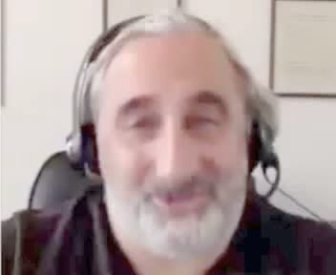
How Real Scientists Think: Example

Slide 14
NEVER FORGET!
  Anyone that tells you to…
  Follow the science
  And then sounds confident, certain, self-assured about what the science is and what steps should be taken based on this science…
  Is not acting like a scientist!

Slide 15

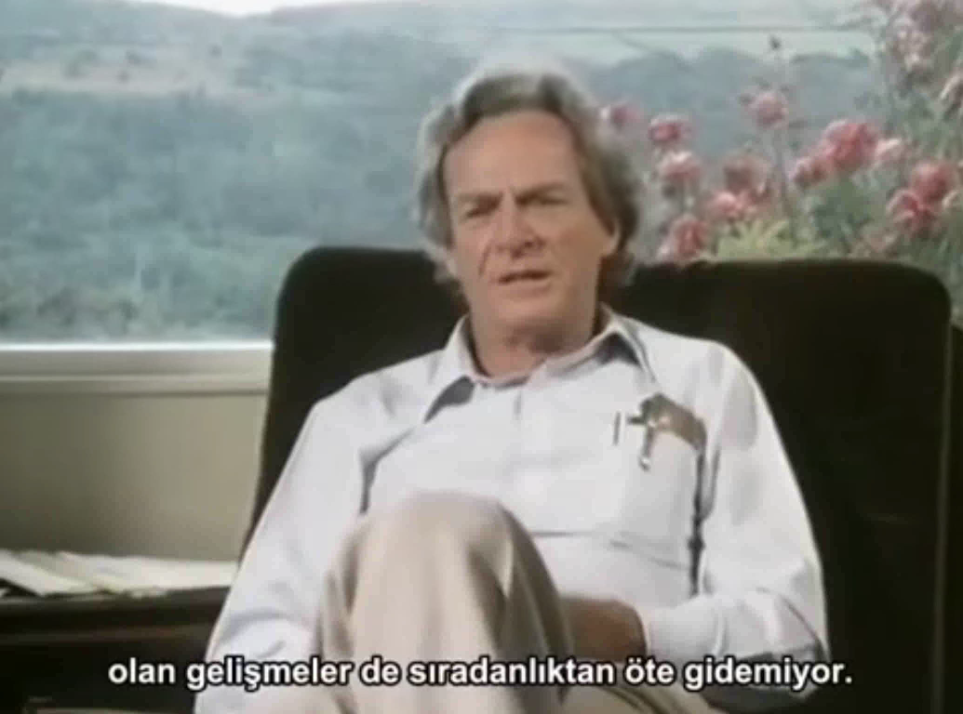
Let’s Listen to Richard Feynman about “How A Scientist Thinks”

Slide 16
Why Does This Matter To Us in 1200?
  Because this is a course in the science of psychology. It’s not a course in what we believe, what our values are, our own personal perspectives or points of view, what a friend told us, what we heard on CBC, etc.
  It’s not a course about…
  What we think things should be like
  It’s not a course about….
  What we think things are like
  It’s a course about…
  What things ARE like

Slide 17
In This Course
You will learn some of the steps in this process of coming to know the world better than we knew it before.
What we will do here is scratch the surface sufficiently to give you some insight in to the real difficulty of understanding how thing really are.
We will learn some things about how science works and the human condition.
But remember….after 35 years doing this, I am less convinced I understand the world than when I started. So, the rule is, humility, humility, humility…you don’t know the world any where near as well as you think you do.

Slide 18
So What Are The Basic Questions A Scientist Asks?
What is X? Definition
How many X are Y? Description
What is the relationship between X and Y? Correlation
What is the effect of X on Y? Causation
If we change X, what will happen to Y? Prediction
Why is X related to Y? Explanation
Now
Future

Slide 19
Research Design
This is about how the data are collected and audited. Not about how the data are analyzed.
Statistics and data analysis have to do with how the data are analyzed once they have been collected.
Basic Distinction: Experiments vs non-experiments
Basic Distinction: Laboratory study vs naturalistic observation
Experiments: In psychology, this involves the random assignment of subjects to conditions. The conditions differ on what we call the Independent Variable…IV.
Example: Randomly assign 37,000 subjects to two conditions. One condition receives a drug, one receives a placebo.

Slide 20
Lab and Experimental Controls
Experimental control is random assignment.
Lab control: Some important types of control are:
  Blinding
  Equivalence of groups
  Subject eligibility criteria
  Follow-up

Slide 21
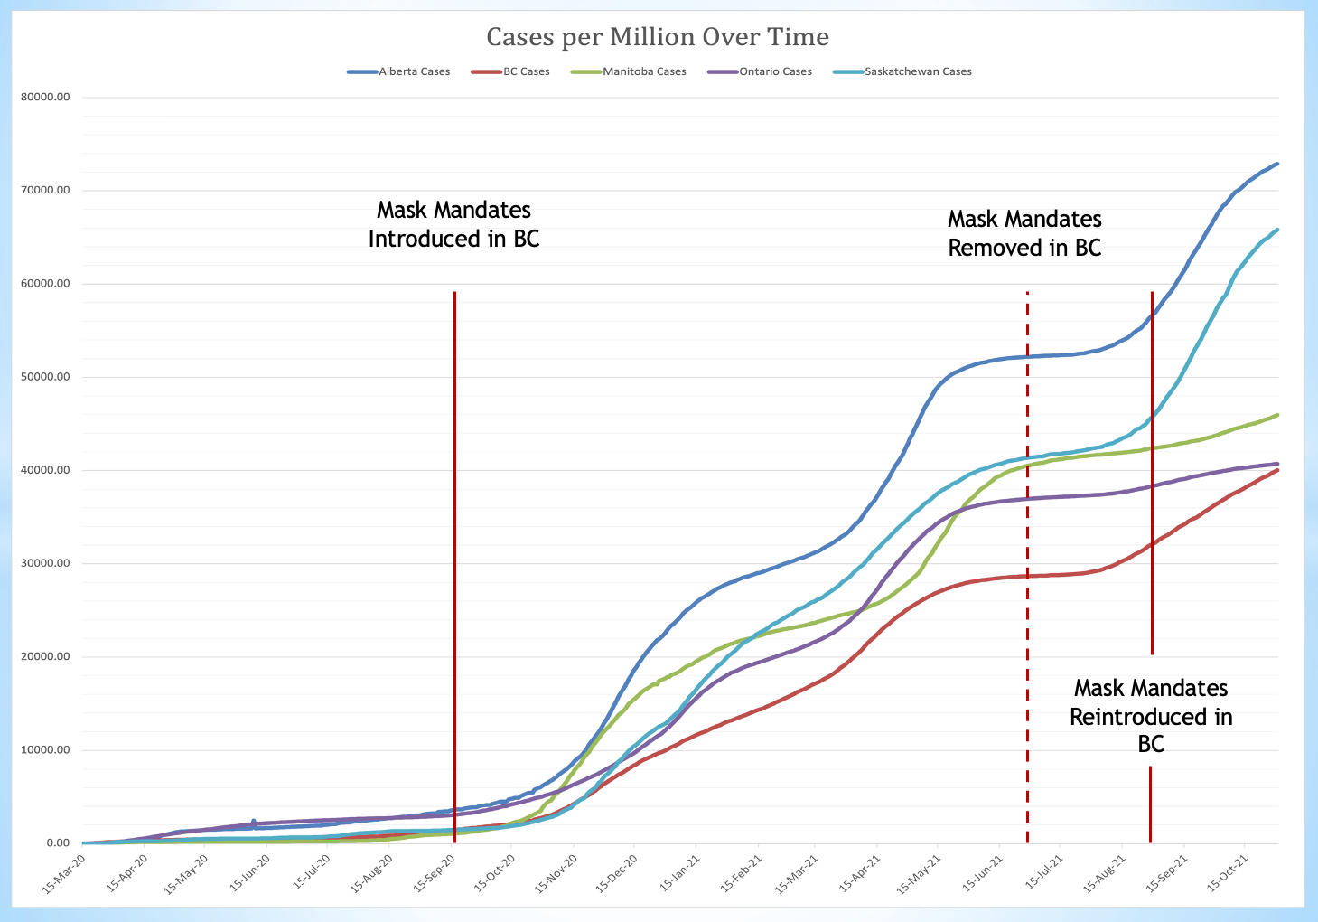
Quasi-Experimental Designs
No random assignment of subjects to conditions, but different “non-equivalent” conditions AND introduction of an intervention at some point in time.
Example:

Slide 22
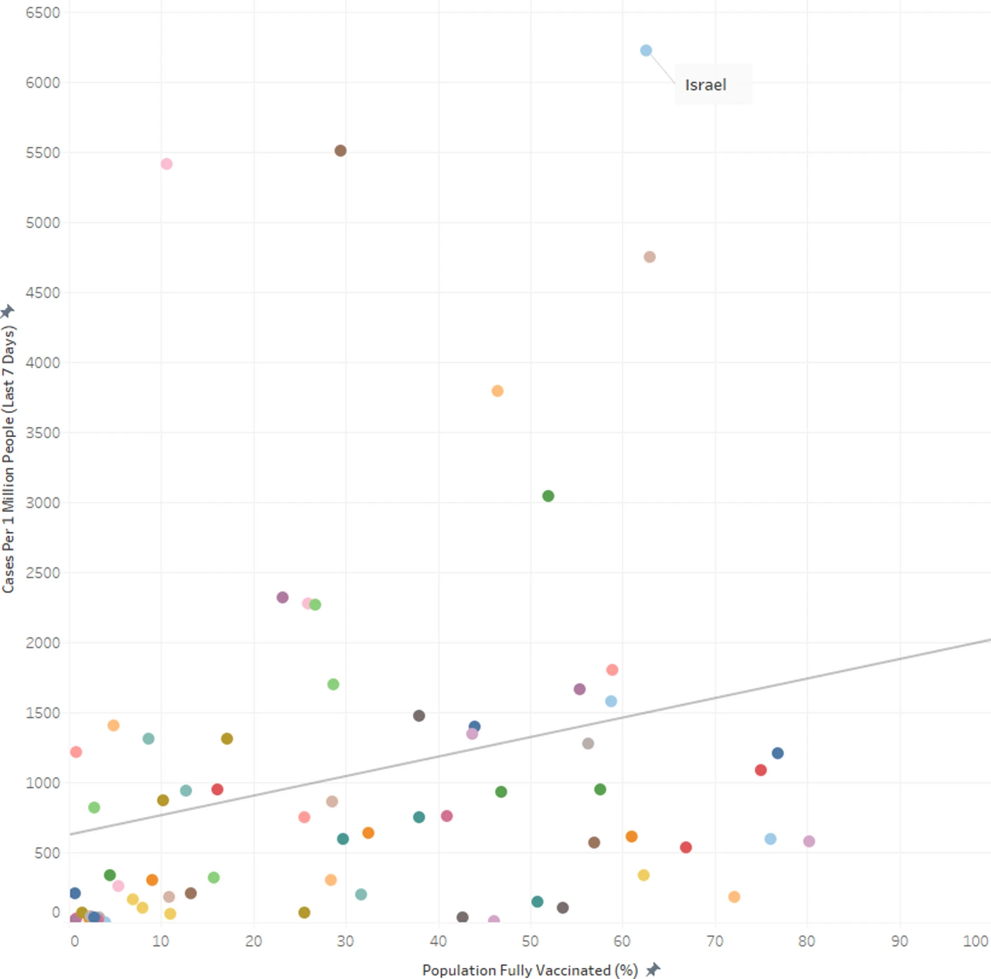
“Correlational” Designs
No random assignment of subjects to conditions, no introduction of an intervention at some point in time.
Example:

Slide 23
Statistics and Data Analysis
Statistics: Has to do with the use of samples to make statements about the populations from which the samples were drawn.
You will learn about two types in psychology:
  Hypothesis testing
  Estimation
Data Analysis has to do with representing features of a data set. So, for instance, how big or small are the numbers, how variable are the numbers, etc.

Slide 24
Hypothesis testing
A logical, decision making method in which we decide to reject or not reject an assumption we make about the population from which the sample was drawn.
Logic:
    Make an assumption about the population (null hypothesis)
    Decide what the sample data must look like in order for us to reject our assumption (decision rule)
    Collect data from a sample (experiment)
    Make decision (decision)
Example:
    Assume: Prime Minister is honest
    If 5 or more of the next 10 statements are not true, conclude PM is not honest.
    Observe next 10 statements and find 6 were not true.
    Decide PM not honest.

Slide 25
Hypothesis testing
Technical example:
    Assume: Vaccine not more effective than placebo.
    If at least 2% fewer people die of the disease in the vaccine condition than placebo condition, conclude vaccine more effective than placebo.
    Follow 18,500 people that get the vaccine and 18,500 people that get placebo and observe 0 % fewer people die of the disease in the vaccine condition than in the placebo condition.
    Decide vaccine not more effective than placebo.

Slide 26
Estimation
This is about ESTIMATION…NOT DECISION MAKING.
The point is to use a sample to estimate the state of affairs in the population.
So, we draw a sample of 18,000 people and follow them for 10 weeks. We find that 3 of the people are hospitalized with a disease. This is 3/18,000=.00017% hospitalization rate over 10 weeks.
A confidence interval is a range we place around a sample estimate within which we have a reasonably high confidence that the actual population rate falls.
So we might say…we estimate with 95% certainty that the true rate of the disease in the population is between .000001% and .001%.

Slide 27
Data Analysis
The purpose is to represent features of a set of data. Involves:
  Reduction
  Summarization
  Conveying of meaning
So, let’s say we calculate the mean of the following 3 numbers: 3, 3, 3, 5, 5, 5, 5, 7, 7, 7. The mean is 5. We have reduced, and summarized the data and conveyed meaning about an aspect of the data.
Be careful! Different meaning is conveyed by different forms of analysis.
Consider…”The drug reduces disease specific mortality by 100%” sounds very good right.
BUT consider…“In 10,000,000 people that did not get the drug, 1 died of the disease. In 10,000,000 people that did get the drug, 0 died of the disease”. However, “1000 people that took the drug died and 1 person that did not take the drug died”. Sounds bad.

Slide 28
Data Analysis: Location vs Spread
Mean, median, mode about location.
Standard deviation, AAD, range about spread.
Location= how much, how big. Spread=how similar, how consistent.
They are independent of each other. Big does not mean consistent.
What would you rather own…Sushi A or Sushi B?

Slide 29
Ethics
We could do multiple courses on ethics alone!
Here I would like to deal with just two issues:
  Informed consent
  Free expression of ideas/censorship

Slide 30
Informed Consent
Three ideas:
  Subjects and patients must be FULLY informed of what is known about both the benefits and harms of any study or procedure.
  Subjects and patients must give consent prior to participation and must be allowed to withdraw consent at any time during the procedure.
  Subjects and patients must not be persuaded, manipulated, coerced or forced to participate in any research project or to undergo any medical procedure.

Slide 31
UNESCO Declaration of Human Rights
Article 5
Autonomy and individual responsibility
The autonomy of persons to make decisions, while taking responsibility for those decisions and respecting the autonomy of others, is to be respected.
Article 6
Consent
1. Any preventive, diagnostic and therapeutic medical intervention is only to be carried out with the prior, free and informed consent of the person concerned, based on adequate information. The consent should, where appropriate, be express and may be withdrawn by the person concerned at any time and for any reason without disadvantage or prejudice.
2. Scientific research should only be carried out with the prior, free, express and informed consent of the person concerned.
3. In no case should a collective community agreement or the consent of a community leader or other authority substitute for an individual’s informed consent.

Slide 32
Censorship
A fundamental idea in science….The evidence is ALL of the evidence. It follows that one or a few research studies within an area are NOT THE EVIDENCE.
They are only a part of the evidence. All of the evidence is often called…
THE BODY OF EVIDENCE
The basis for all interpretations of a field of study in science must be based on the body of evidence, not part of the evidence.
This is why censorship can not be tolerated. Interpretations will depend upon the parts of the evidence that are available. If some parts of the evidence are censored for whatever reason (financial conflicts of interest, political purposes, etc.), then it is impossible to assess the body of evidence and so impossible to assess the evidence.

Slide 33
UNESCO Declaration of Human Rights
Article 19
Right to Freedom of Opinion and Expression
The right to communicate is a fundamental human right that underpins the very essence of democracy, and it is a key factor in the fulfillment of other rights. States are prohibited from restricting speech and beliefs, and have an obligation in protecting the right to freedom of opinion and expression.
It “includes the right to hold opinions without interference and to seek, receive and impart information and ideas through any media and regardless of frontiers.”

Slide 34
Let’s Do An Exercise
  Discussion Question 1
On what basis did you form your views about the severity of COVID-19 and the efficacy of measures used to slow the spread of the SARS-COV-2 virus? Comment on how dangerous you thought it was, so the likelihood of hospitalization and and/or death. Discuss why you thought what you did about the severity of COVID-19. Was your view based on the body of evidence? What was the evidence? To what extent was your view based in non-evidentiary factors that contribute to dogmatism. So for instance, fear, anxiety, personal experience, anecdotal stories or accounts, media reports, political messages and announcements, etc.
Do the same for measures designed to reduce the risk of the disease to others. So for example, masks, lockdowns, travel mandates, restaurant restrictions and closures, vaccines, vaccine mandates, etc.
Discuss how the formation of your view relates to the principles of science discussed in chapter 2 and in this lecture and whether or not you formed your view in an ethical, scientific manner.

