Slide 1
Psychology 1200
Lecture 4
Mental Disorders

Slide 2

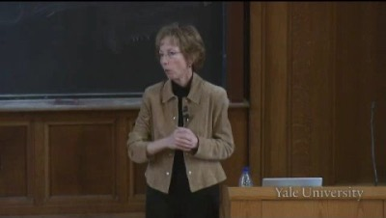
What is A Mental Disorder

Slide 3
Definitions
I was taught and I taught students for many years until recently…
A mental disorder is atypical, disturbing, unjustified and maladaptive.
Your book says….
A persistent disturbance or dysfunction in behavior, thoughts, or emotions that causes significant distress or impairment.
Nolen-Hoeksema says…
Subjective judgement about whether a person's symptoms meet behavioral or emotional criteria. Criteria have to do with abnormality, and/or whether the individual or others around them are distressed, dysfunctional or deviant.

Slide 4
Definitional Issues
Subjective
Non-biological or physiological.
Not precise
Different over time and between people
A function of culture, gender and/or social context
Abnormality???
So what’s the issue?
The definition of mental disorder is NOT operational!

Slide 5
Operationism Reminder
What something is, is given by the technical definition of it (method 3).
We make up technical definitions. They have 4 features:
  Clear
  Unique
  Public & shared
  Fairly stable over time
For example…we are not interested in water, that is not technically defined. We make up H2O and define it technically.
We are not interested in intelligence, that is not technically defined. We make up IQ or g and define it technically.

Slide 6

So What?

Slide 7
The Problem
“Diagnosis” was not really diagnosis; it was merely a form of “labelling”.
“Diagnosis” was highly subjective.
Psychiatrists could be easily duped.
Psychotropic drugs could be legally prescribed when patients were not ill or suffering from a real disorder or disease.

Slide 8
The Response
DSM….Operationism
Gives the perception of objectivity
Gives the impression that “diagnosis” is medical.
Instantiates the “medical model” as the basis for diagnosis and treatment of MENTAL ILLNESSES.
Provides health insurers with a seemingly objective basis for compensation.
Establishes psychiatry as a fully justified medical specialty.

Slide 9
The Medical Model
Cause | Condition | Symptoms | Treatment
Biological |  | Biological | Drugs/surgery
Psychological | Disease/Illness | Psychological | Therapy
Social |  | Social | Lifestyle modification
Cause | Condition | Symptoms | Treatment
High BP |  | Chest pain | Drugs
Anxiety | Heart disease | Fear | Counselling
Stress at work |  | Withdrawal | Change job

Slide 10
The Medical Model: Depression
Cause | Condition | Symptoms | Treatment
Biological |  | Biological | Drugs/surgery
Psychological | Disease/Illness | Psychological | Therapy
Social |  | Social | Lifestyle modification
Cause | Condition | Symptoms | Treatment
Neurotransmitters |  | Insomnia | Drugs
Feelings of worthlessness | Depression | Guilt | Counselling
Loss of job |  | Withdrawal | Change job

Slide 11
You!
All of this is why…
YOU THINK
Mental disorders are illnesses related to abnormal brain function and that they can be treated with medication.
Now let's look at the problem with this…

Slide 12
The Medical Model: The Problem
Cause | Condition | Symptoms | Treatment
High BP |  | Chest pain | Drugs
Anxiety | Heart disease | Fear | Counselling
Stress at work |  | Withdrawal | Change job
Cause | Condition | Symptoms | Treatment
neurotrans |  | Insomnia | Drugs
Feelings of worthlessness | Depression | Guilt | Counselling
Loss of job |  | Withdrawal | Change job

Slide 13
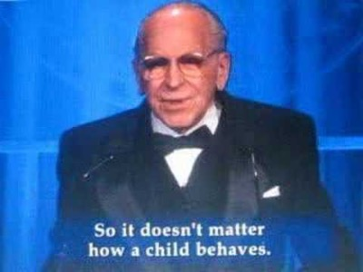
A Cautionary Example: ADHD

Slide 14
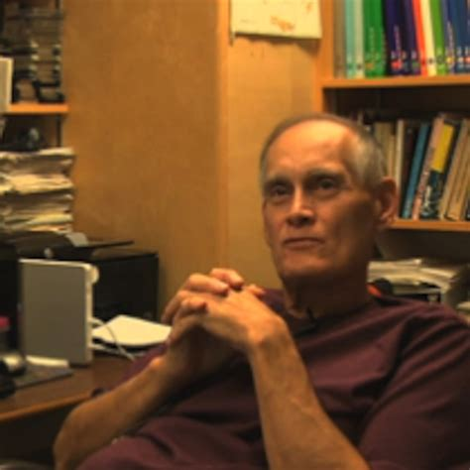
A Cautionary Example: RSS
Present-day symptomology found in Aboriginal Peoples and societies does not constitute a distinct psychological condition, but is the well known and long-studied response of human beings living under conditions of severe and prolonged oppression.
Although there is no doubt that individuals who attended Residential Schools suffered, and continue to suffer, from the effects of their experiences, the tactic of pathologizing these individuals, studying their condition, and offering "therapy" to them and their communities must be seen as another rhetorical maneuver designed to obscure (to the world at large, to Aboriginal Peoples, and to Canadians themselves) the moral and financial accountability of Euro-Canadian society in a continuing record of Crimes Against Humanity.

Slide 15
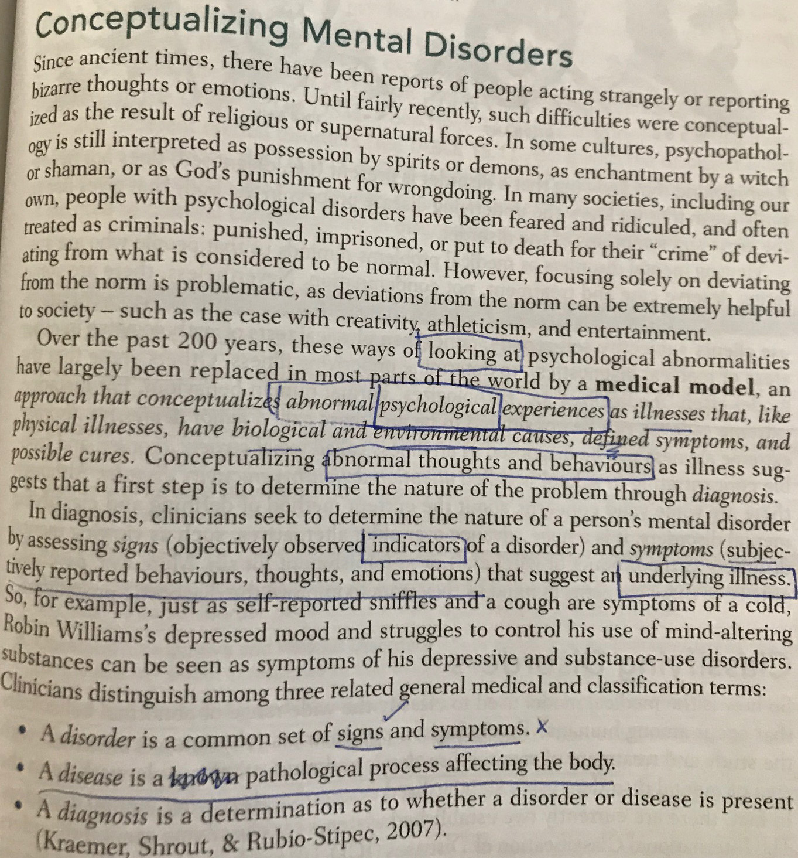
What Does Your Text Say?

Slide 16
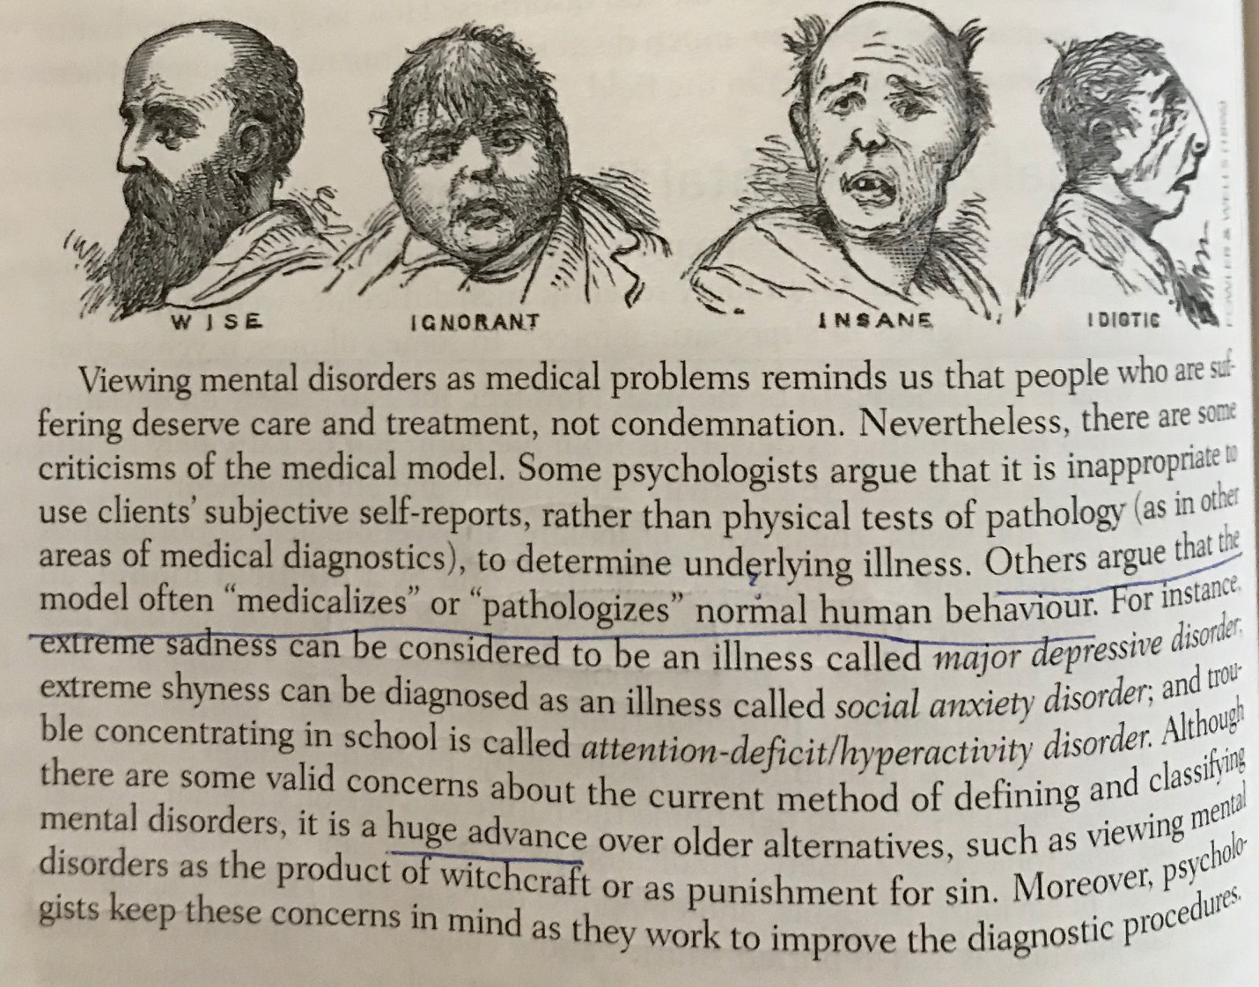
What Does Your Text Say?

Slide 17
A Huge Advance Or…?
So, is the medical model and advancement or is it just different?
DISCUSSION QUESTION 4
What is the right way for psychologists to conceptualize mental disorders? Should we use medical language like illness, diagnosis and treatment? Does all this medical language help or does it hinder us to properly understand and deal with mental disorder?
Find sources from the internet that argue for and against the medical model. What are they saying? Does it make sense? Take the arguments from lecture into consideration in your response.

