Slide 1

Psychology 1200
Risk Homeostasis Theory

Slide 2
Risk Homeostasis Theory
A type of motivational Drive Reduction Theory
Invented by Gerald Wilde in the mid 1970’s
Explains how humans take risks and/or modify their behavior in response to risk
Very relevant to what happened during COVID
Most generally applied to the traffic environment

Slide 3
So what?
RHT predicts that….
Speed limits do not reduce accident loss
Better tires, brakes, road surfaces, seat-belts, etc., do not reduce accident loss.
The only thing that does work is changing people (or deceiving people).

Slide 4
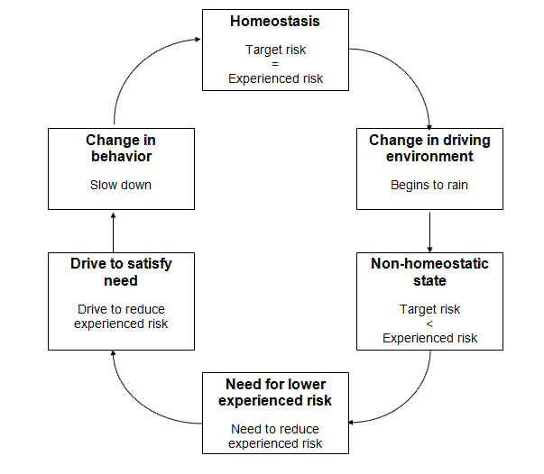
So what?
RHT predicts that….

Slide 5
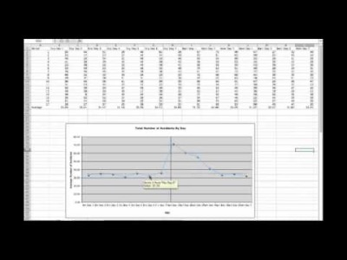
An Example
A study done in Vancouver BC….

Slide 6
Relation to COVID
If we can get people to THINK/BELIEVE experienced risk is….
HIGHER than it actually is…
we can get them to engage in behavior that….
OVERCOMPENSATES
for the actual risk in the environment. For instance…
Wear masks
Take experimental drugs
Engage in medical discrimination

