Slide 1
Psychology 3301
Lecture 1

Slide 2

What do we want to know about the world?
How is the world now?
2) How will the world be in the future?
It turns out that we are very good at “1” but not so good at “2”
Consider this….
How is it that we CAN NOT predict the temperature in one location very well 7 days in advance but we seem pretty confident that we CAN predict the climate all over the globe very well 70 years in advance?

Slide 3

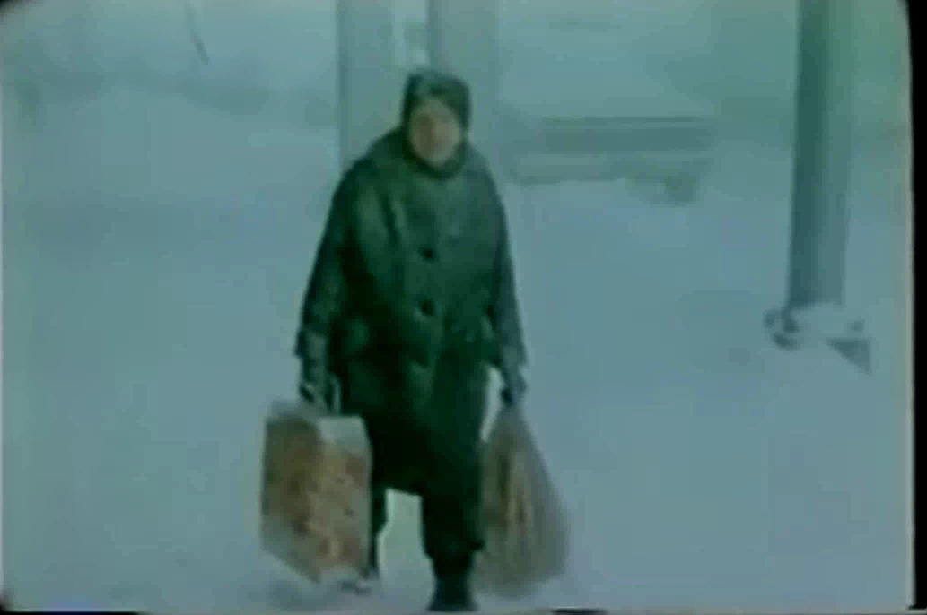
Climate Change predictions In 1978…Watch

Slide 4
Why a Good Description of The Present State is Hard Enough.
It turns out the describing the way things are at the present moment is extremely difficult.
Consider this question…At the present time is COVID-19 serious?
This is a question about the present state, what are the issues?

Slide 5
COVID: The Present State
  How do we define serious?
    What measure should we use? Deaths per million, total deaths, total cases, cases with symptoms, death rate, case transmission rate, deaths to local residents or global deaths, years lost or total deaths, deaths in relation to influenza in a normal year, deaths due to influenza last year, excess deaths in the population, deaths with Covid or deaths from Covid, total deaths now or in 2 years from now, in 10 years from now, etc.
  2) Does the seriousness depend upon how we define serious?
    If so, what definition of seriousness should be used? Who should define serious, should we all use the same definition of serious? Can we compare countries if different definitions are used by different countries, etc.

Slide 6
COVID: The Present State
  3) Does the seriousness depend upon third factors and if so, what are they?
    Which of the numerous ways of measuring seriousness are a function of age? Is age actually a risk factor or is it merely a mediator variable? Does ethnicity matter? What about pre-existing conditions, population density, immune system health, diet, geographic location, economic status of the population, economic status of the individual, etc.
  4) Does seriousness depend upon our ability to manage it?
    What about health care system capacity, sophistication of the health-care system, public or private health care system, social distancing measures used, mask wearing, therapeutics, vaccines, governmental orientation towards civil liberty, etc.
  5) What are the costs to other things of managing it?
    What is the effect of government policy on other diseases, causes of death, mental health, alcoholism, drug-abuse, economic well-being, suicide, quality of life, how do we equate the costs of government strategies to the benefits, etc.

Slide 7
Description and Complexity: The Take Away
  So the moral of the story is simple, a description of the present state is very, very difficult.
  From a methodological point of view, there are a vast number of relevant, interacting variables that are often impossible to measure and a host of very difficult definitional problems that make a big difference to our interpretation of the effects of any attempt to change the world.
  It follows from this that it should never be presumed by intuition, common sense or by our own ad hoc perspective what the effect of a change in the world might be.
  The appropriate orientation then is careful, serious, expert data collection and analysis and a healthy dose of scepticism that the problem is well understood or can be definitively solved.

Slide 8
Why Does This Matter To Us in 3301?
  Because this is a course in applied research methods. It’s not a course in laboratory research methods.
  The difference is that in the lab, we control intervening, moderating, mediating and interacting variables. We control for covariates, we control the environment, we control who the subjects are using eligibility criteria…..we control all of those things that are unknowns and/or possible confounds in the real-world.
  That means that results obtained in a lab are far simpler to interpret and understand than results obtained in the real world. In the real-world we are “constrained” in our ability to understand by the complexity of the context.

Slide 9
Why Does This Matter To Us in 3301?
  Consider research on the effect of masks for reducing the spread of a virus.
  Lab research on mask efficacy is done in a controlled environment in which we monitor the environment, the subject, the way in which the mask is used, the measurements of efficacy we take, etc.
  We do this to eliminate the effect of all of these variables on our research findings.
  But the very process of elimination makes the research findings non-generalizable to the real-world context in which environments vary dramatically, types of masks vary, methods of mask wearing vary, compensation of behavior to mask wearing varies dramatically and so on.
  The very process of experimental elimination may make the findings true but irrelevant!

Slide 10
Back to The Future
In business and public policy, we need to at least try to predict the future, however poor we might be at doing it.
The scientist has a warning for us though…The so-called positivist warns that prediction is not observation. And, they argue, good science is rooted in observation. The positivist warns that prediction is speculative, and speculation does not constitute good science.
Even though speculating about the future is necessary and expected in business, the good business person listens to the scientist about the dangers of speculation.

Slide 11
Back to The Future
I once had a boss who said angrily in an executive meeting….
  “Don’t give me your 5 year plan, we might be bankrupt in 5 years. Tell me what you are doing today, tell me what you are doing now to grow the business!”
I would say most of the good scientists and good business people I have met are oriented towards current reality rather than speculations about the future.
Let’s listen to Freeman Dyson about this.

Slide 12
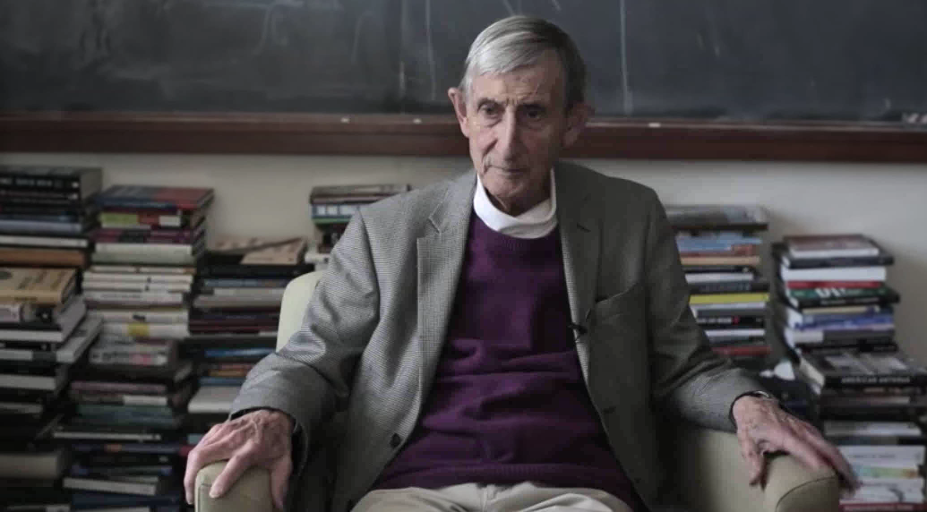
Freeman Dyson

Slide 13
Let’s Listen to Freeman Dyson
Climate scientist James Hansen said of Freeman Dyson…
  “If he's going to wander into something with major consequences for humanity and other life on the planet, then he should first do his homework—which he obviously has not done on global warming.”
Dyson’s response was…
  “My objections to the global warming propaganda are not so much over the technical facts, about which I do not know much, but it’s rather against the way those people behave and the kind of intolerance to criticism that a lot of them have.”
What is meant by…”the way those people behave?” Let’s listen to Richard Feynman on this question.

Slide 14
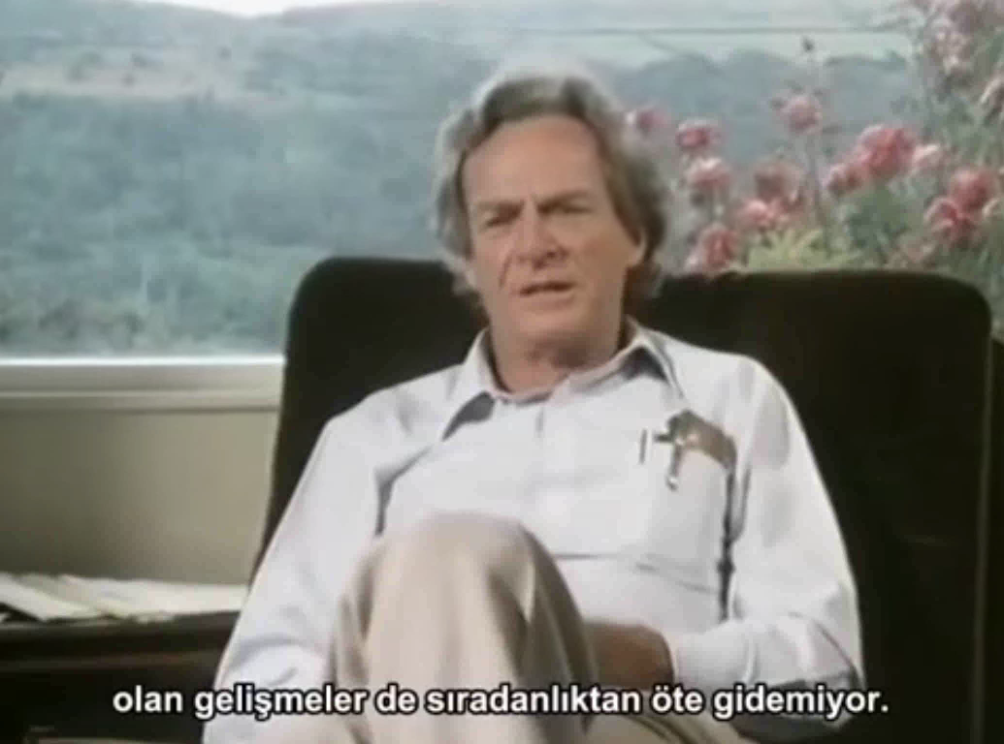
Let’s Listen to Richard Feynman about “The Way Those People Behave”

Slide 15
What’s The Disagreement About?
There are many issues but one important issue derives from the positivist attitude towards knowing the world.
Dyson and Feynman are theoretical physicists. They are trained in a positivist way of looking at the world. They respect first and foremast observation, not speculation about the future, conjecture or theory.
Statements about the present state of the world are inherently non-speculative, they are inherently descriptive. The positivist views description to be the core purpose of science.
So Dyson is saying…we already know now what we must do, and that does not depend on any guess or speculation about the future… which he thinks is impossible 100 years in advance.
Feynman is saying that knowing even the present state is very difficult and so we should not be so sure we know how things are going to be.

Slide 16
What’s The Disagreement About?
We will see specific examples later in the course of how complex and difficult understanding even the present state is never mind what the state of the world will be in the future.
Here a professor at Cambridge speaks to this complexity in an assessment of the risks associated with COVID-19.

Slide 17
What’s The Disagreement About?
In order to even begin to understand the present sate, data must be properly collected, it must be checked, it must be replicated, analyzed carefully and interpreted with humility and caution.
In this course, you will learn some of the steps in this process.
We will learn about data collection, types of data bases, auditing, how to use statistical software to analyze data, and how to interpret the results of our analyses.
What we will do here is the scratch the surface sufficiently to give you some insight in to the real difficulty of understanding how thing really are.

Slide 18
So What Are The basic Questions About Now and About The Future?
What is X? Definition
How many X are Y? Description
What is the relationship between X and Y? Correlation
What is the effect of X on Y? Causation
If we change X, what will happen to Y? Prediction
Why is X related to Y? Explanation
Now
Future

Slide 19
Let’s Do An Exercise
Question 1: What is a COVID Death in the US? What is a COVID case in the US?
Question 2: By state…How many COVID deaths have there been in the US? How many COVID cases have there been in the US?
Question 3: What is the relationship between COVID cases and deaths, in Washington State and time? That is, how have cases and deaths changed over time in Washington?
Question 4: Based on your analysis, is COVID-19 serious? Use the CDC website for the data. Let’s take a look at a video on how to go about this exercise here…
Useful url’s:
    Link to Citrix Instructions: https://www.douglascollege.ca/student-services/student-resources/it-services/logins-passwords
    Link to CDC page containing information on definition of COVID death: https://www.cdc.gov/nchs/nvss/covid-19.htm
    CDC data by state and time: https://data.cdc.gov/Case-Surveillance/United-States-COVID-19-Cases-and-Deaths-by-State-o/9mfq-cb36

Slide 20
What to Do With Your Findings
Go to Blackboard and find the “Discussion” folder in the main menu.
Go to this folder and make a post on the discussion forum…”Exercise Number One”.
Answer each of the questions and take a look at what other students are saying abut this.
Engage other students on the final question of whether or not COVID-19 is serious.

Slide 21
In Considering Your Answers
Be careful…definition comes before description
Be careful …description comes before explanation
Be careful about the first two steps in the game…without a good definition and a good description, forget about relationships, causation, prediction and explanation.
Consider the question…When will it be safe to return to in-person teaching in colleges and universities? What definition does the answer to that question depend upon?

Slide 22
Appendix A
Introduction to SPSS: https://youtu.be/M4ARqul_ZU8
The SPSS split file command: https://youtu.be/5FrJdfIxflg
The SPSS select if command: https://youtu.be/qCcjCUGYCqU
The SPSS merge command: https://youtu.be/nRGu6_HGHRI
The SPSS compute command: https://youtu.be/vmGg3fWGxaY
The SPSS recode command: https://youtu.be/NqLGBNx6Q5o
The SPSS if command: https://youtu.be/9dIS4W3t05E
The SPSS random variable command: https://youtu.be/9mkMaTWx6DU

