Slide 1
Psychology 3301
Lecture 3

Slide 2

Recall…

Slide 3
Research Design, Continued
In 35 years as a consultant methodologist and statistician, I have never seen an experiment conducted in the real world. Experiments are done in academic research environments, not in the real world.
Why? Because in the real-world, there is no random assignment of subjects to conditions. It’s not practical.
So, in the real-world we mostly see descriptive studies, and quasi-experiments.
Consider the masses of COVID-19 data you have seen. Have you seen any experiments?
What we tend to see are descriptive methods…how many X are Y and quasi experiments…what is the relationship between X and Y.

Slide 4
Research Design: No Random Assignment of subjects to Conditions
In this category we have descriptive studies, surveys, naturalistic studies, interviews, quasi-experiments, cohort studies, etc.
These constitute the vast majority of research studies conducted in both a real-world and academic contexts.
They typically lack the controls necessary to make strong causal claims. Such claims are reserved for designs in which there exists random assignment of subjects to conditions, in which the conditions differ on the putative ‘causal” variable…the IV.
Consider the “How well we have done in BC” arguments about managing COVID deaths. Have we randomly assigned subjects to BC and “Other countries/states”?

Slide 5
The Quasi-Experiment and Causal Claims
To understand why causal claims are problematic in quasi-experimental contexts, we need to review some basic quasi-experimental methods.
Let’s start with the post-test only design. An intervention followed by a measurement of a DV.
The most basic design but very common in industry.
Imagine we conduct a sales training program in which we provide a day of sales training and ask participants at the end of the day…
How confident are you in your sales ability?
Let’s say our scale is 1-7 with 7 being very confident and 1 being not confident at all. Now let’s imagine the average score is 6.2.
Data derived from designs like this are very commonly used to justify that a program or initiative is effective.

Slide 6
Post-Test Only Design Problems
So what’s the problem here?
There are three major problems:
  i) The “in comparison to what” problem
  ii) The “generalizability” problem
  iii) The “measurement” or “meaning” problem
The conclusion is…”Sales training programs are effective”, the justification is…participants took a sales training program and reported a high level of confidence in their sales ability after the program.
The question is… Is the conclusion justified by the method?
Let’s start with the problem of “In comparison to what”?

Slide 7
In Comparison to What
Implied by the statement “sales training programs are effective” is that it’s sales training programs specifically that are effective.
Embedded within this phrase is a “hidden” causal claim. But is it justified on the basis of a post-test only design?
So, imagine we ask prospective participants that took no sales training program at all the same question. Imagine a mean score of 6.3.
Given this comparison to another group, a causal claim seems difficult to justify.
What about comparison to a previous point in time? What if we ask the same question before the program begins and get a mean of 6.3. Now, we see a reduction in confidence after the program. Again, evidence that a causal claim is not justified.

Slide 8
In Comparison to What
My wife recently told me that she had read a news article in which it was reported that France is going in to lockdown again.
I asked… “Why”?
She said…because ICU’s are at 70% capacity.
I asked even before thinking…
“What is the normal percent capacity at this time of year”?
She said she did not know and that it was not reported in the news article.
Even though we technically know from our research methods courses that comparisons are important, it is extraordinarily common for us not to fully recognize this in the real-world when dealing with real-world problems.

Slide 9
The Generalizability Problem
The question here is whether or not the results of this post-test only design can generalize to other contexts, types of programs, program leaders, etc.
Since only one kind of program was conducted at one point in time with one set of participants, and in one context, the method does not justify the conclusion that the results can be generalized beyond the research context.
What conclusion is justified? This program, conducted by these people, in this context, at this point in time, for these participants was…
Let’s look at the translation of this idea of generalizability to our thinking about the effect of things in our daily lives…Let’s APPLY this methodological principle.

Slide 10
The APPLIED Generalizability Problem: COVID Example
Consider the phrase…
“COVID-19 is a serious disease”.
The generalizability problem is…Is COVID serious in all contexts, for all people, across time, etc.?
Let’s consider an example…
  ”What is the relationship between residing in a retirement home and the seriousness of COVID-19”?
In Canada, based on the latest data, 81% of the 10,000 COVID deaths have been in retirement homes. Let’s do a quick calculation…

Slide 11
The APPLIED Generalizability Problem: COVID Example
Given that 81% of the 10,000 deaths were in retirement homes and that approximately 128,000 Canadians live in retirement homes, the risk of death for residents of retirement homes is…
.81(10,000)/128,000=.063
Now, the risk of death to all 37,600,000 Canadians, excluding residents of retirement homes is roughly something like…
.19(10,000)/(37,600,000-128,000)=.00005
So, given these admittedly rough, highly conditional calculations, it’s clear that the risk of death is a huge function of who the “participants” are.
The seriousness of the disease then is highly conditional, and so not generalizable across segments of the population.

Slide 12
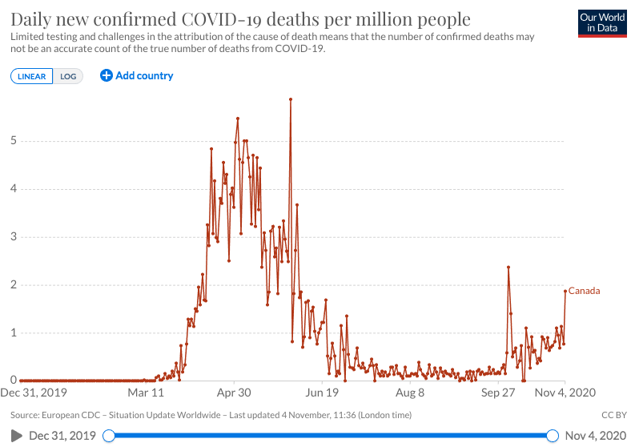
The APPLIED Generalizability Problem: COVID Example Over Time
When we say “COVID is a serious disease”, we do not make the statement conditional on time. So we generalize to all times by making the statement this way.
But is the seriousness of COVID a function of time?

Slide 13
The Measurement/Meaning Problem
To what extent does the post-test only design address the measurement or meaning problem?
What is the measurement/meaning problem?
Consider the statement…
”Sales training programs are effective”.
The measurement/meaning problem is…
How do we measure effective?
And that question depends upon…
What do we mean by effective?

Slide 14
The Measurement/Meaning Problem
Does effective mean….
Self-reported perception of competence on a scale of 1-7
Does it mean…
Total sales per day of all products and services
Does it mean…
Percent of total sales force sales per day
The issue of course is that there are an infinite number of ways of conceptualizing “effective”.
The problem is that the definition we choose will effect our conclusions about efficacy.

Slide 15
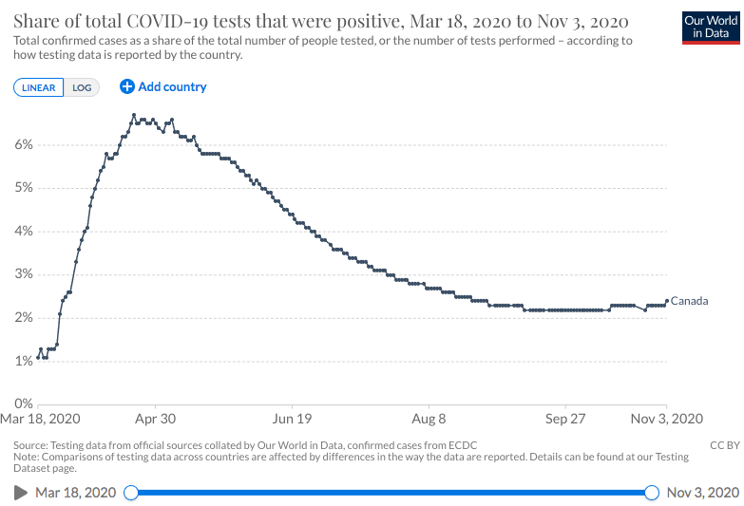
The Measurement/Meaning Problem:
COVID Example
Is COVID serious? What do we mean by serious? Let’s say we mean “Serious if percent of positive tests above 5%”. Let’s look at some data.
Serious between the end of March and the end of June

Slide 16
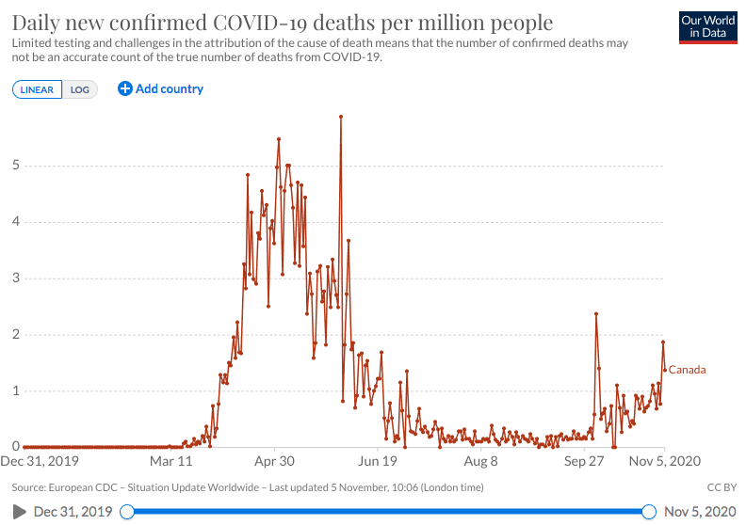
The Measurement/Meaning Problem:
COVID Example
Let’s say we mean “Serious if daily deaths per million in Canada greater than 1”.
Not serious
Serious
Not serious
Serious

Slide 17
The Measurement/Meaning Problem:
COVID Example
But what if we mean “Serious if daily deaths per million not residing in retirement homes more then 1 per million”.
Not serious
Not serious
Serious on 2 days in last 10 months

Slide 18
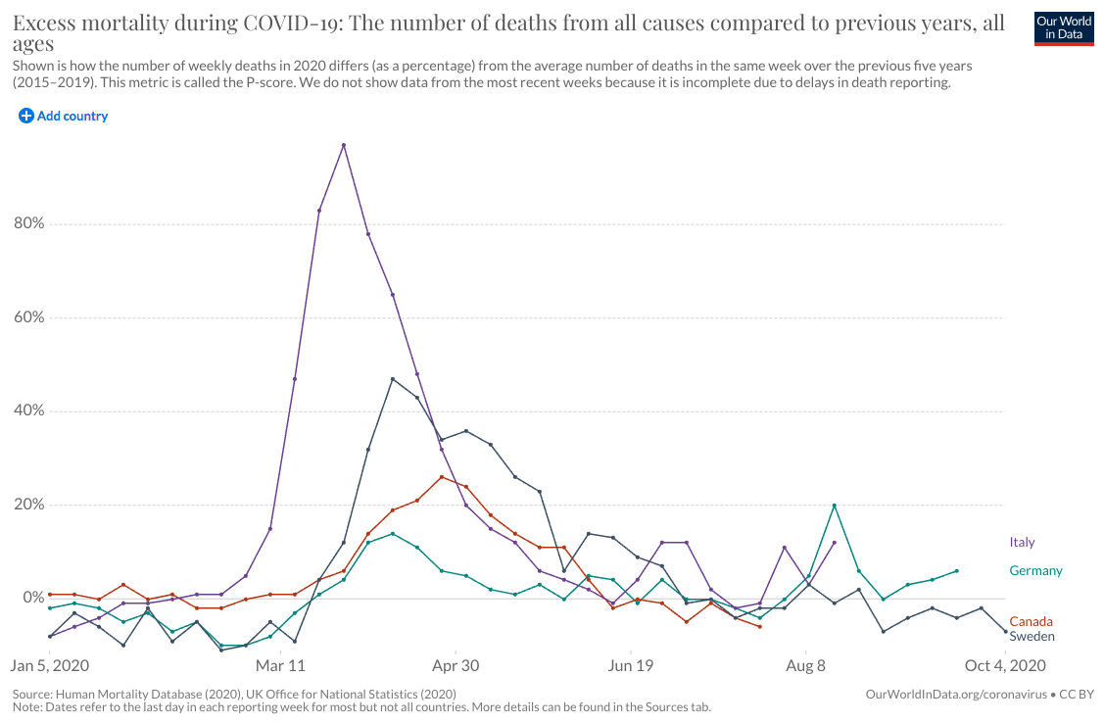
The Measurement/Meaning Problem:
COVID Example
What about…”Percent of total excess deaths in comparison to the same day over the previous 5 years”.

Slide 19
The Measurement/Meaning Problem:
The Take-Away
How we define and measure serious matters.
Not just a lot it’s, in Wittgenstein’s words and from the perspective of an operationist, fundamental to the problem.
Consider this…when will it be safe to return to university in-person teaching?
What does that depend upon…the definition of safe to return.
I encourage you to look for one. Listen to our experts…have they given one?
I think you will find that they have not. It follows then that it can not be known when it is safe to return because we do not know what safe to return means.

Slide 20
Back To Quasi-Experimental Designs
We started with post-test only design and realized quickly that this kind of design suffers from a fundamental “In comparison to what” problem.
We address this issue in two ways.
  Pre-test type design
  Non-equivalent control designs
In pre-test designs we use either a single pre-test and single post-test or multiple pre-tests and multiple post-tests.
Where we use multiple pre and post-tests, we call these series designs.
In non-equivalent control designs, we measure the variable of interest in more than one group. Let’s look at pre-test, post-test designs

Slide 21
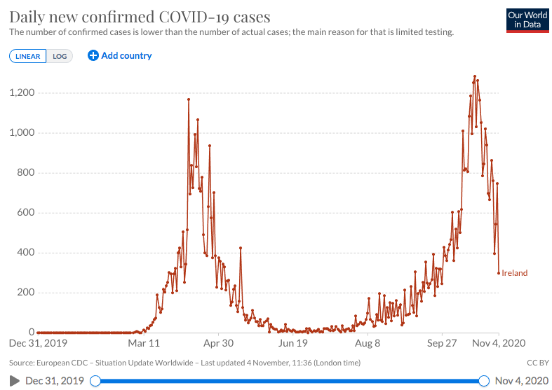
Pre-Test, Post-Test and Series Designs
Let’s look at some quasi-experimental design data on the efficacy of masks in reducing COVID cases.
Masks mandated
PRE
POST

Slide 22
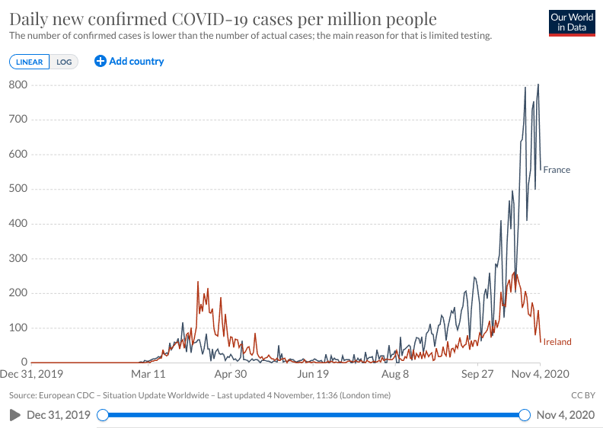
Pre-Test, Post-Test and Series Designs
Let’s look at France. They introduced compulsory masks on September 1.
Ireland
France
PRE
POST

Slide 23
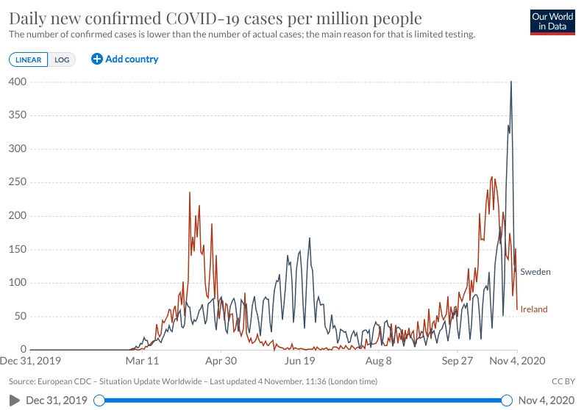
Non-Equivalent Control Series Designs
Let’s look at Ireland as the experimental group and Sweden as the non-equivalent control.
Ireland Introduces Masks, Sweden Does Not

Slide 24
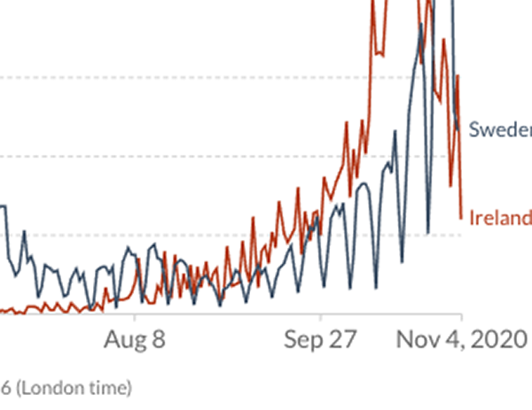
Non-Equivalent Control Series Designs
Let’s zoom in for a more clear picture.
Ireland Introduces Masks, Sweden Does Not

Slide 25
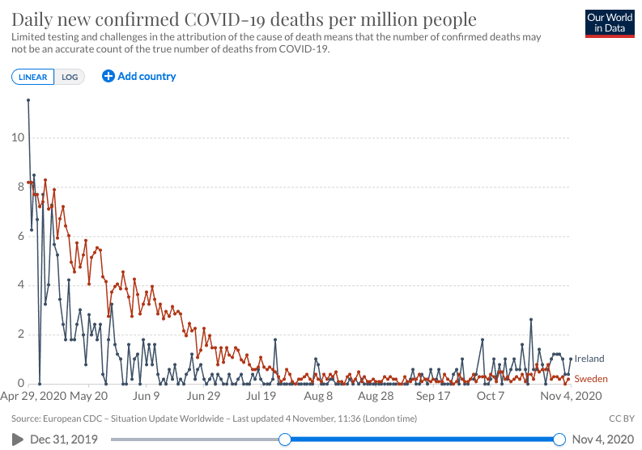
Non-Equivalent Control Series Designs
Just for fun, what about daily deaths per million as a different definition of serious.
Ireland Introduces Masks, Sweden Does Not

Slide 26
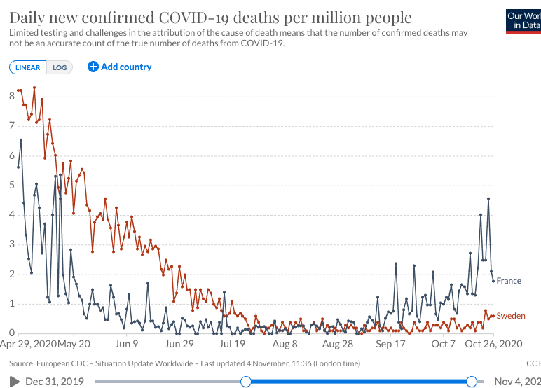
Non-Equivalent Control Series Designs
Maybe it’s just Ireland. What about France?
France Introduces Masks, Sweden Does Not

Slide 27
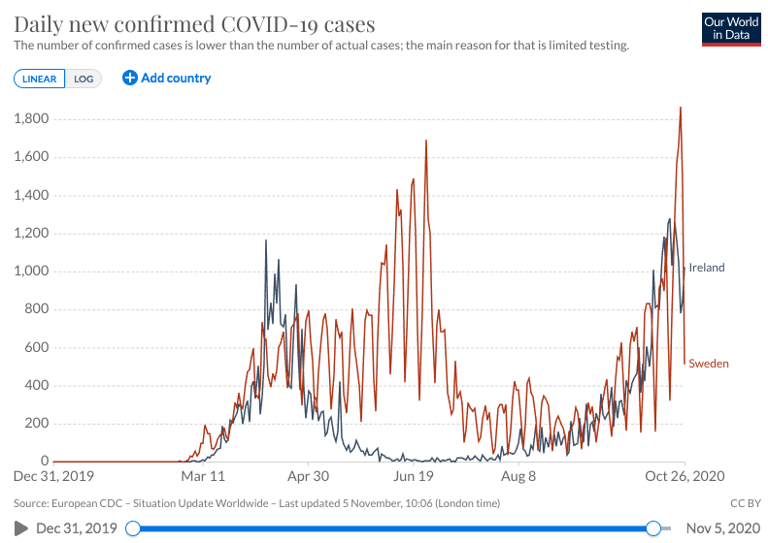
The “Best” Design: Non-Equivalent Control Series Reversal Designs
What happens when we introduce and then remove lockdowns?
Lockdowns in Ireland
gradually lifted
Lockdowns in Ireland
gradually tightened
No lockdown
in Ireland
Lockdown in Ireland

Slide 28
In Comparison To What: The Take Away
The comparison question is fundamental to our conceptualization of a problem.
In the famous words of Thomas Sowell (who I encourage you very much to follow), there are no solutions, there are just trade-offs.
This means two things from our point of view:
  When we modify something in the world (we impose mask wearing laws, we elect a new leader, we open safe injection sites, etc.), many things will happen. Some things will get better, some thing will get worse, some things will not change at all.
  When we compare two groups (experimental group vs. non-equivalent control for example), some things will be better for one group, some things will be worse and some things will be the same.
Consider this…

Slide 29
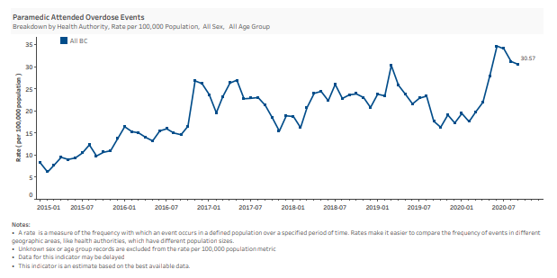
In Comparison To What: The Take Away
What has happened to overdose deaths in BC since response to COVID began in March of 2020?
COVID Restrictions Introduced
Dramatic Increase
Same time 2018, no change
Same time last year, dramatic decrease
Same time 2017, no change
Same time 2017, decrease
Understanding this “In comparison to what” issue and putting in to practice in your own thinking about the world is an antidote to simplistic thinking and simplistic world views.

Slide 30
In Comparison To What: One More Very Important Issue To Keep in Mind
The comparison question is fundamental to our conceptualization of a problem. But part of the question is when or at what point in time we choose to engage the comparison.
This is known as the apriori vs post-hoc problem.
Imagine we give the graphs of cases or deaths to a statistician or researcher but do not say when the intervention was initiated. So, for instance, we do not say when mask wearing restrictions were instigated.
The question is, can we tell apriori…or before…we know when the intervention was implemented when it was, in fact, implemented by analysis of the case and death rates.

Slide 31
In Comparison To What: One More Very Important Issue To Keep in Mind
So, look at the cases graph below…can you tell when mask wearing was initiated in Ireland?
The question is, how do the apriori guesses compare to the post hoc reality? Would you be accurate in your guess?

Slide 32
Apriori vs Post-Hoc Problem: Take Away
We have a tendency to think that we are much better at predicting the future than we really are.
Why is that?
Partly because we do not fully understand the risks associated with post-hoc thinking. Or, in more common language, “I told you so” or “I knew it all along” or “I said this would happen” thinking.
The antidote to this is to state clearly, in advance, one’s expectations and then review those expectations after the fact.
This is the familiar idea of stating one’s research hypothesis in advance and then evaluating the data against the hypothesis.
We do this technically but almost never in the real-world.

Slide 33
Apriori vs Post-Hoc Problem: Take Away
For instance, a statement was recently made in British Columbia that a type of lockdown is required in order to reduce the number of COVID cases in ICU. Methodologically, this is called a research hypothesis.
So, strictly speaking, a methodologically oriented person might state, in advance of the lockdown, how much reduction should be expected in COVID ICU cases following the lockdown.
Strictly speaking, this should be stated in such a way that it is possible to FALSIFY the hypothesis.
That is, it should be stated clearly enough to determine whether or not the lockdown did actually have the expected effect.
Watch for this in your own predictions and in your own thinking about the world.
If you do, you’ll find out that you are much worse at predicting the future than you think!

Slide 34
Exercise Two
In this exercise, I’d like you to conduct a Non-equivalent control reversal series design.
You should use a data file I have created with 74 rows and over 100 columns. Subjects are years and columns are a vast array of variables from number of deaths on Everest each year to ocean heights in the Boston harbour.
The independent variable I would like you to use (the variables we will be introducing and reversing numerous times in the “US party in power”. This indicates whether a republican or democratic national government was in power in a given year in the USA.
The dependent variables I would like you to use are: the annual per capita electric power consumption, C02 emissions in tons per capita and income in US dollars per capita.
The non-equivalent control is Canada.

Slide 35
Exercise Two
STEP 1: Graph Co2 emissions per capita in the US by year.
STEP 2: Place lines on the graph indicating years of democratic and republican government.
STEP 3: Name the design and draw conclusions about the effect of government on Co2 emissions.
STEP 4: Add a non-equivalent control to the graph, Canada, and revise your conclusions if necessary.
STEP 5 Discuss why you revised or did not revise your conclusions and why it is so important (or not) to cite data that allows an analysis of the “in comparison to what” problem.
STEP 6: Repeat this procedure for the other two DV’s and discuss.
Finally: Say what you think the effect of the government is on these economic and environmental variables. Use the variable “fertility rate in the US” to provide insight.
Watch a video here on how to go about this analysis in SPSS.

Slide 36
What to Do With Your Findings
Go to Blackboard and find the “Discussion” folder in the main menu.
Go to this folder and make a post on the discussion forum…”Exercise Number Two”.
Answer each of the questions and take a look at what other students are saying about this.
Engage other students on the final question of whether or not the party in power has an effect on the variables in question.

