Slide 1
Psychology 3301
Lecture 8

Slide 2
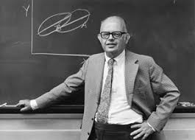
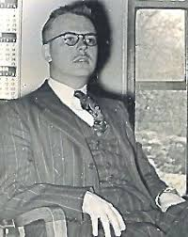
Psychological Measurement
Lee Cronbach: 1916-2001
Paul Meehl: 1920-2003

Slide 3
Cronbach and Meehl
Paul Meehl was elected president of the APA in 1962
Lee Cronbach invented the famous statistic called Cronbach’s alpha…he was ALSO a president of the APA (1957)
These could be the most important pair of researchers in the history of psychology
In 1955 they published the famous and incredibly influential paper… Construct Validity in Psychological Tests

Slide 4


Paul Meehl Teaching A Graduate Class In 1989

Slide 5
Construct Validity Theory
A philosophy of science
Specifically, a method for justifying the claim that a test is a valid measure of a construct…For instance…
Is an IQ test a valid measure of intelligence?
Or…
Is a student course evaluation a valid measure of course quality?
Cronbach and Meehl suggested that one way to determine this is by using the methods and logic of CV Theory

Slide 6
Types of Validity: Construct vs. Criterion
There are 4 types of validity. In the first 3 a criterion must exist. These are known as types of criterion validity:
  Predictive validity: A test has predictive validity as a measure of a CRITERION if the test is correlated with the criterion and the criterion is measured after the test. E.G: High school GPA has predictive validity as a measure of college GPA because they are correlated with each other and college GPA is measured some time after high school GPA.

Slide 7
Criterion Validity
A criterion must exist:
  Concurrent validity: A test has concurrent validity as a measure of a CRITERTION if the test is correlated with the criterion and the criterion is measured at the same time as the test. E.G: Diameter of a tree has predictive validity as a measure of height of a tree because they are correlated with each other and diameter of a tree is measured at the same time as height of the tree.

Slide 8
Criterion Validity
A criterion must exist:
  Content validity: A test has content validity as a measure of a CRITERION if the test items are representative of the criterion. Quiz 2 has content validity as a measure of chapters 8-10 if the items on the quiz are taken from chapters 8-10 (and not say chapter 5).

Slide 9
Construct Validity
There is no criterion:
  Construct validity: A test has construct validity as a measure of a CONSTRUCT if the test correlates with what it should be correlated with if it were a measure of the construct.

Slide 10
The Logic of Construct Validity Theory
Construct validity is relevant when there is no operational definition (a CRITERION)
Construct validity is not just a way to validate tests, it’s a way to validate constructs as well. We ask:
  Is test X a valid measure of construct Y. E.G: Are student evaluations valid measures of course quality?
  What does construct Y denote: E.G: What is course quality?

Slide 11
The Logic of Construct Validity Theory
What is the difference between a construct and an operational definition (a criterion)?
An operational definition is unique, clear, public, shared, etc. It is…precise and agreed upon. IQ is operationally defined.
A construct is not well defined…it is open to interpretation, perhaps vague, not formally defined, etc. It is imprecise and there exist competing theories about what it is. Intelligence is a construct. course quality is a construct.

Slide 12
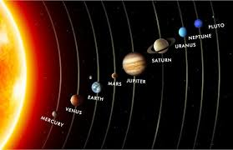
An Example of The Process of Establishing a Criterion: The Case of A Planet

Slide 13
The Logic of Construct Validity Theory
So…a criterion is laid down. We make that up.
But a construct is fundamentally different.
We believe it is too vague, broad, open, etc., to be defined operationally.
  So what do we do when we can not agree upon a criterion?
Construct validation

Slide 14
The Logic of Construct Validity Theory
So…according to CV Theory, how do we determine what a construct is and/or what construct a test measures?
There are a number of fundamental principles but they mostly come down to the idea that:
  What something correlates with is evidence about what it is.
E.G.: Depression correlates with insomnia, therefore, depression is partly physical.

Slide 15
How Do We Determine What an Item Measures?
If we have two items that have a strong correlation between each other, this is evidence that the two items measure the same thing.

Slide 16
Constructing Tests to Measure Constructs: Validating Tests
It follows then that items on “tests” should all correlate with each other if the test measures one thing. Tests are constructed to measure one thing and validated as follows:
1) Bring together a large number of items that may have something to do with each other. We call this face validity. We do this by choosing items that have very roughly similar meaning.
  E.G. “I like the clashing colours of modern art” & “I would like to try skydiving”
  E.G. “I feel sad” & “I feel agitated” & “I have lost interest in my work”
  E.G. “This course was fun” & “This course was challenging”
2) Obtain responses of a large number of subjects to each of the items.
3) Retain items that correlate with each other and discard items that do not correlate with the retained items.
4) Based on the meaning of the retained items, form an hypothesis about what the test measures.
  E.G. Hypothesize that a set if items measure sensation seeking.
  E.G. Hypothesize that a set of items measures depression.
  E.G. Hypothesize that a set of items measures course quality.
5) Give the items and indirect measures of the hypothesized construct to subjects and determine the correlation between the items and the indirect measures.
  E.G. Determine the correlation between the items hypothesized to measure “sensation seeking” and riskiness of investment portfolio, or ownership of a motorcycle, or relative safety of chosen profession (mountain climber vs. accountant).
6) If the items correlate with the hypothesized measures, take this as evidence that the items do, in fact, measure the hypothesized construct.

Slide 17
Fundamental Principles of CV Theory
The more evidence we gather with a test, the more validated the test becomes.
There is no such thing as the end of validation…we can always gather more evidence.
Not all interpretations of the evidence will be the same. Therefore, there will almost always be competing theories about what a test measures. This is why we have “multiple theories of intelligence” or multiple “theories of addiction”. We do not agree on how to interpret the evidence obtained with IQ tests or people taking drugs.
There is no such thing as an index of validation. There is no such thing as a measure of how valid a test is as a measure of a construct.
If the test correlates with what it should correlate (if it were a measure of what we claim it measures), we say the test has convergent validity as a measure of the construct we claim it measures.
If the test does not correlate with what it should not correlate (if it were a measure of what we claim it measures), we say the test has discriminant validity as a measure of the construct we claim it measures.

Slide 18
Relationship to PCA and Factor Analysis
A component or factor is a mathematically constructed variable that the items on the test correlate with. We can correlate the “FACTOR SCORES” or “COMPONENT SCORES” with each of the items to determine the size of the correlation.
If the correlation of an item with the factor/component is between .3 and .8, we conclude the item measures the factor.
What does the factor/component measure then?
Something that all the items measure.
What is that thing?
  We develop a theory about what it is based on the meaning of the items that are most strongly correlated with the factor. We NAME the factor based on the items that are correlated with the factor. What something is, is given by what it correlates with!

Slide 19
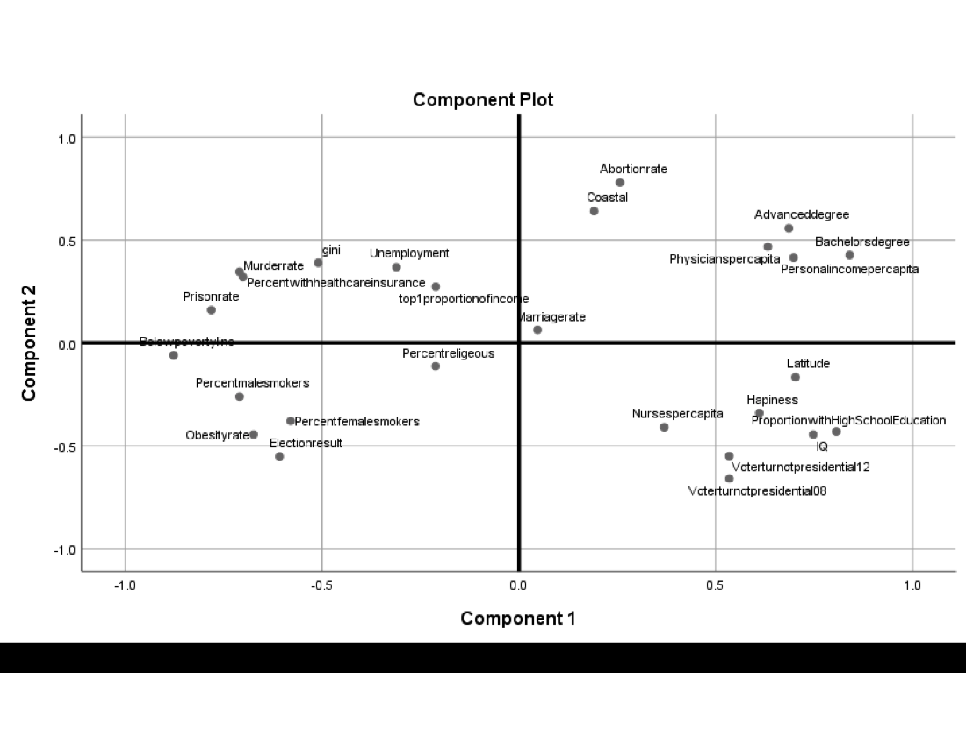
What Does Component 1 Measure?

Slide 20
Validating Constructs: The Case of ADHD
Theorize that ADHD is an abnormality of the brain.
Hypothesize that if ADHD is an abnormality of the brain, children with ADHD should have different brain structure than children without ADHD. ADHD should correlate with brain structure.
Conduct the experiment. If brain structure is somewhat different in children with ADHD than in children without ADHD, this is evidence that ADHD is a brain abnormality.
If brain structure is not somewhat different conclude: a) We did not measure the right brain structure, or b) the theory that ADHD is a brain abnormality is incorrect.

Slide 21
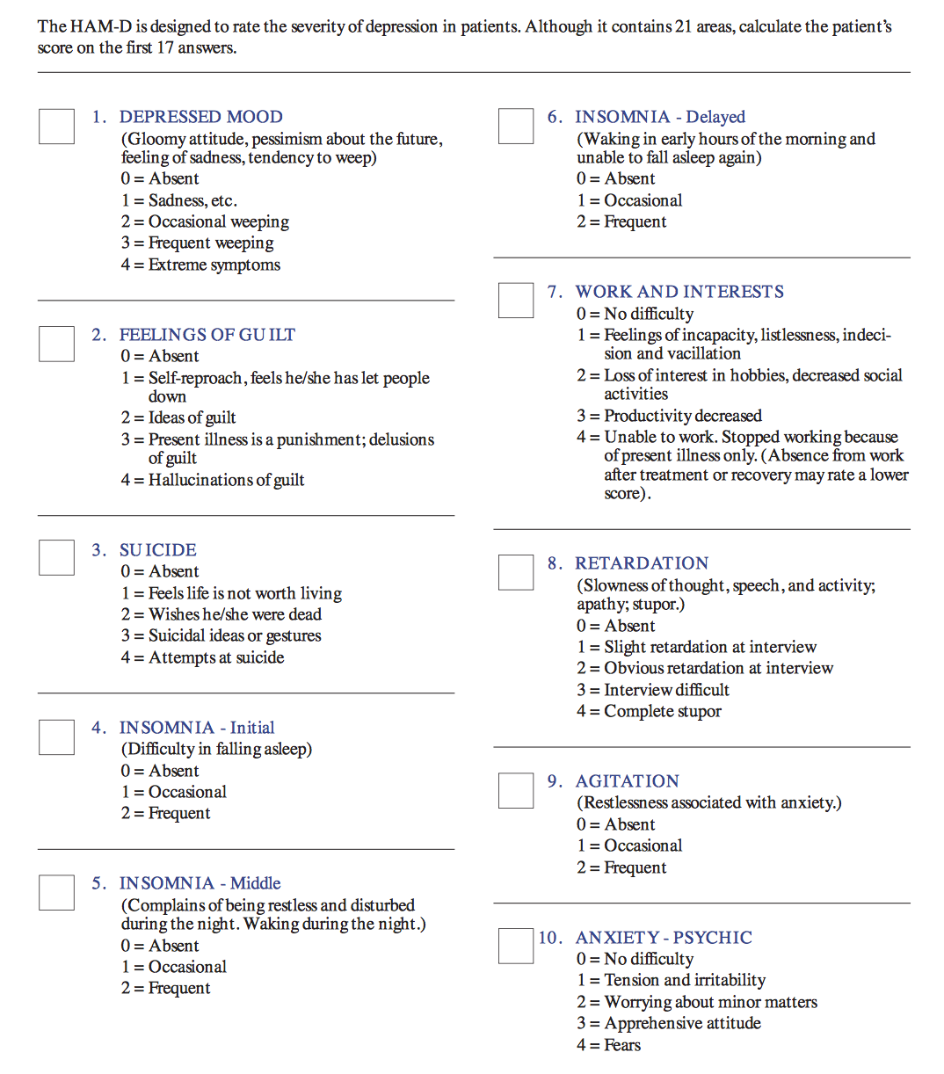
An Example of a “Validated” Psychological Test: The HAM-D

Slide 22
Question?
Why are there questions on the HAM-D that do not denote depression?
Most of the questions on the test denote things that are correlated with depression not depression itself.
In CV Theory, what something is, is given by what it is correlated with and so what a test measures is given by what it is correlated with.

Slide 23
Question?
What is the problem with the logic of CV Theory?

Slide 24
Answer: Two Issues
1) How do we pick items that are roughly related to intelligence in step 1 of test validation if we do not already know what intelligence is?
2) Is it true that what something is correlated with tells us what it is?

Slide 25
Is Correlation=Meaning?
Suppose we measure daily depression using the HAM-D depression scale.
Suppose, on the same days we measure depression, we also measure the amount of rain on the day.
Now, suppose we correlate depression scores with amount of rain and notice that levels of depression are correlated with amount of rain.
According to the logic of CV Theory, this means that a measurement of rainfall is a measurement of depression.

Slide 26
From The APA Task Force On Research Methods
“Naming a variable is almost as important as measuring it. We do well to select a name that reflects how a variable is measured. On this basis, the name "IQ test score" is preferable to "intelligence”…”
“Editors and reviewers should be suspicious when they notice authors changing definitions or names of variables…”
What are they saying here?

Slide 27
Cautionary Note About CV Theory Logic
These statements are actually warnings against the consequences of using CV Theory logic to justify measurement claims.
They are roughly….we did not measure depression when we measured cloud cover and we should not say that a measure of cloud cover is a measure of depression.

Slide 28
Is The Happiness Rating in Our Gini Data Really a Measure of Happiness?
From the website…
“Happiness can be tough to quantify”
“The researchers at “MagnifyMoney” created a state ranking of where the happiest Americans live based on metrics determined by Oxford economists.”
“It might seem impossible to put happiness into numbers but Oxford economists defined it as…”

Slide 29
Is The Happiness Rating in Our Gini Data Really a Measure of Happiness?
Health: Diagnosed depression rates, suicide rate, state health index, life expectancy, air quality, proportion of people getting at least 7 hours of sleep.
Lifestyle: Number of hours spent outside of work, volunteer rate, number of people married, average household size, percent people not using vacation time, divorce rate, social ties, percent people exercising regularly.
Economic Stability: Percent people own their homes, median household income, unemployment rate, percent people with at least one late payment on credit card.

Slide 30
Operationism VS. CV Theory
The logical conflict here is over philosophy of science.
In CV Theory, correlation=meaning.
In operationism (a philosophy of science that is incompatible with CV Theory) correlation ≠ meaning.
In operationism, meaning is given by definition. The fact that X correlates with Y or that X causes Y, does not show that X and Y mean the same thing.
In operationism, the fact that cortisol levels correlate with anxiety levels does not show us that anxiety is a brain state. The fact that hours spent outside work is correlated with happiness, does not show us that happiness is free time.

Slide 31
Validating a Scale Using SPSS
There are two approaches:
Classical Test Theory approach
Item Response Theory approach.

Slide 32
Validating a Scale Using SPSS: Classical Test Theory Approach
In order to be valid measures of a single construct items must be empirically homogeneous.
We assess empirical homogeneity using Pearson correlations between items. The following are all appropriate:
Pearson correlation matrix between the items. Pearson r greater than .3 is evidence the two items measure the hypothesized construct.
Cronbach’s alpha greater than .7 is evidence the items measure the same construct.
Any measure such as Split-half, Spearman Brown, etc.
Go to “Analyze”, “Scale”, “Reliability Analysis”.

Slide 33
Validating a Scale Using SPSS: Item Response Theory Approach
In order to be valid measures of a single construct, the items must fit a unidimensional model. The model is the factor. The factor represents some “underlying”, “hypothetical” construct measured by the items.
We assess empirical unidimensionality by subjecting the items to a factor analysis.
If 1 factor is “extracted” in the analysis, we say the items are unidimensional. This is the claim that they measure 1 thing.
What is the 1 thing they measure? We intuit/hypothesize/ conjecture this based upon the meaning of the items that have correlations of more than .3 with the factor.
This has been called the DISS procedure by a psychometrician at SFU.
What does “extracted” mean? We need a course in measurement for that!

Slide 34
Something VERY Interesting
Did Cronbach and Meehl, the inventors of CV Theory, agree with it?
“Without in the least advocating construct validity as preferable to the other three kinds (concurrent, predictive, content), we do believe it imperative that psychologists make a place for it in their methodological thinking, so that its rationale, its scientific legitimacy, and its dangers may become explicit and familiar.”

